Slide 1
Time gating algorithm to correct S parameters measurements
Germán Augusto Ramírez Arroyave
CMUN

Slide 2
Contents
Theoretical background
Processing examples
Limitations
Further reading

Slide 3
Ideas behind
Given an S parameter measurement perturbed with multiple reflections, the effect of the main obstacle (object of interest) can be isolated by means of time domain filtering (gating).
Discrete Frequency and Time domain signal processing involved.

Slide 4
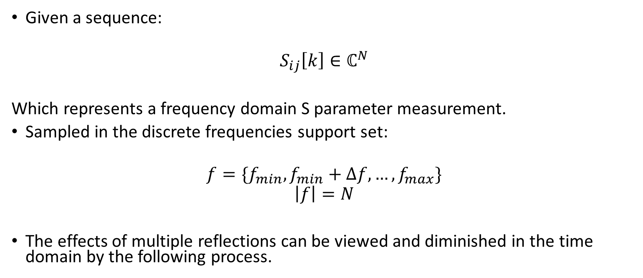
Processing steps I
Given a sequence:
$$S_{ij}\left[k\right]∈ℂ^{N}$$
Which represents a frequency domain S parameter measurement.
Sampled in the discrete frequencies support set:
$$f=\{f_{min},f_{min}+Δf,…,f_{max}\}$$
$$\left|f\right|=N$$
The effects of multiple reflections can be viewed and diminished in the time domain by the following process.

Slide 5
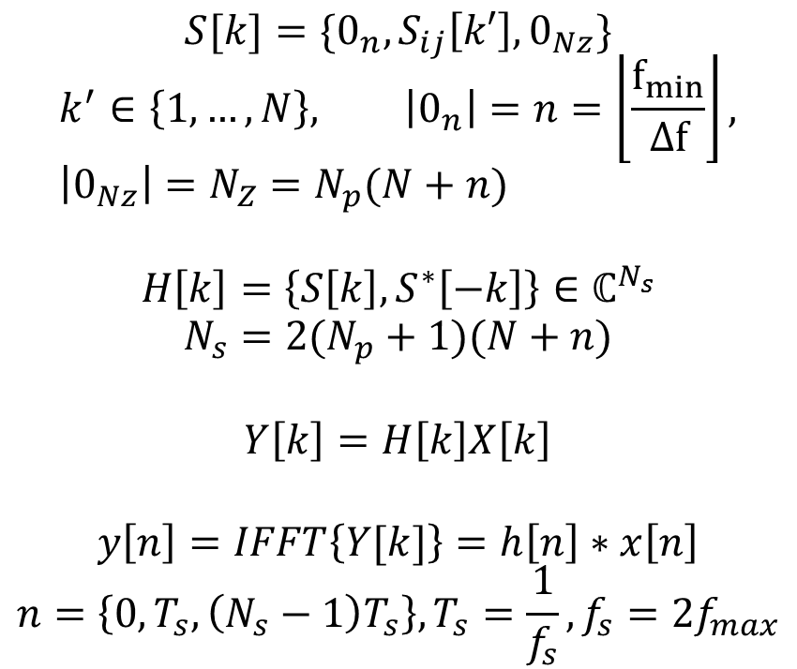
Processing steps II
$${S[k]=\{0_{n}, S}_{ij}\left[k′\right], 0_{Nz}\}$$
$$k^{′}∈\left\{1,…,N\right\}, \left|0_{n}\right|=n=\left\lfloor \frac{f_{min}}{Δf}\right\rfloor , \left|0_{Nz}\right|=N_{Z}=N_{p}(N+n)$$
$$H\left[k\right]=\left\{S\left[k\right], S^{∗}\left[−k\right]\right\}∈ℂ^{N_{s}}$$
$$N_{s}=2(N_{p}+1)(N+n)$$
$$Y\left[k\right]=H\left[k\right]X\left[k\right]$$
$$y\left[n\right]=IFFT\left\{Y[k]\right\}=h\left[n\right]∗x\left[n\right]$$
$$n=\left\{0,T_{s},\left(N_{s}−1\right)T_{s}\right\}, T_{s}=\frac{1}{f_{s}}, f_{s}=2f_{max}$$
First, a signal extension to reach zero or near zero frequency and a frequency domain zero padding are carried out.
Then, assuming real impulse response, the transfer function is created mirroring the real part spectrum from the measurement and padding.
Next, a pulse response is calculated in the frequency domain.
Now, the pulse response is transformed to the time domain.

Slide 6
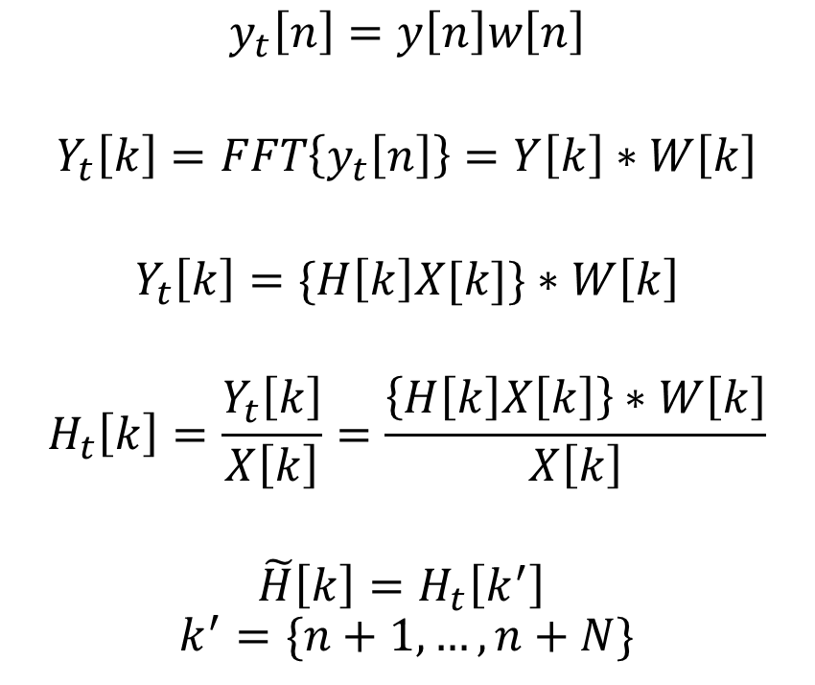
Processing steps III
$$y_{t}\left[n\right]=y\left[n\right]w\left[n\right]$$
$$Y_{t}\left[k\right]=FFT\left\{y_{t}\left[n\right]\right\}=Y\left[k\right]∗W\left[k\right]$$
$$Y_{t}\left[k\right]=\{H\left[k\right]X[k]\}∗W\left[k\right]$$
$$H_{t}\left[k\right]=\frac{Y_{t}\left[k\right]}{X\left[k\right]}=\frac{\left\{H\left[k\right]X\left[k\right]\right\}∗W\left[k\right]}{X\left[k\right]}$$
$$\tilde{H}\left[k\right]=H_{t}\left[k^{′}\right]$$
$$k^{′}=\{n+1,…,n+N\}$$
The pulse response is then truncated by means of a window intended to extract the main reflection in the time domain.
Afterwards, the truncated signal is transformed back to the frequency domain.
Now, the effect of the pulse is removed (not completely due to the effects of windowing).
Finally, the spectrum samples corresponding to the original support are extracted.

Slide 7
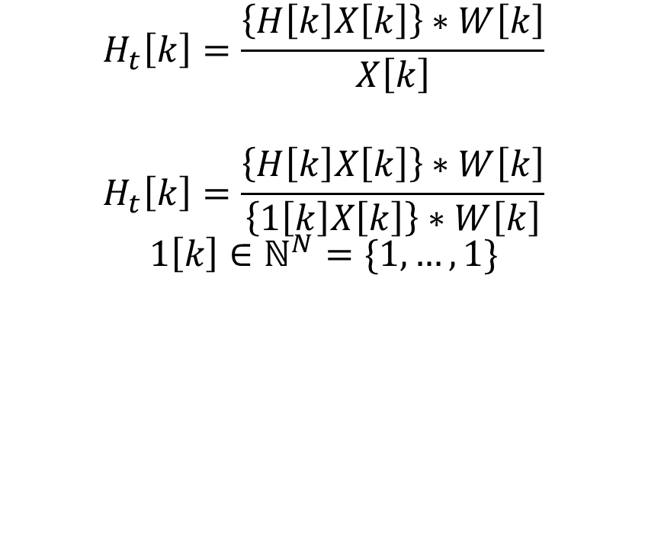
Alternatives
$$H_{t}\left[k\right]=\frac{\left\{H\left[k\right]X\left[k\right]\right\}∗W\left[k\right]}{X\left[k\right]}$$
$$H_{t}\left[k\right]=\frac{\left\{H\left[k\right]X\left[k\right]\right\}∗W\left[k\right]}{\left\{1\left[k\right]X\left[k\right]\right\}∗W\left[k\right]}$$
$$1\left[k\right]∈ℕ^{N}=\{1,…,1\}$$
From the last expression a direct frequency domain implementation can be envisioned.
Some authors suggest the use of a normalization factor which undergoes the same processing as the S parameter measurement.

Slide 8
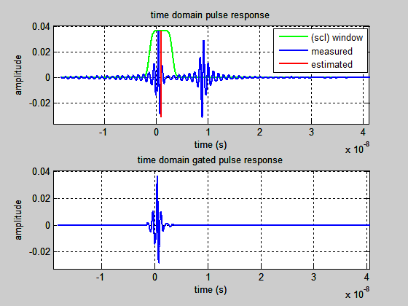
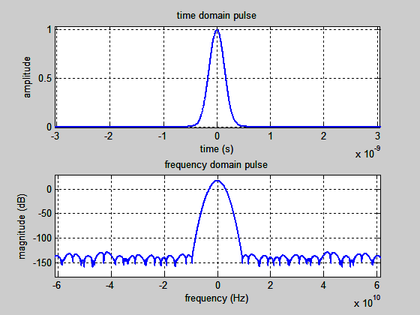
Use examples: transmission line

Slide 9
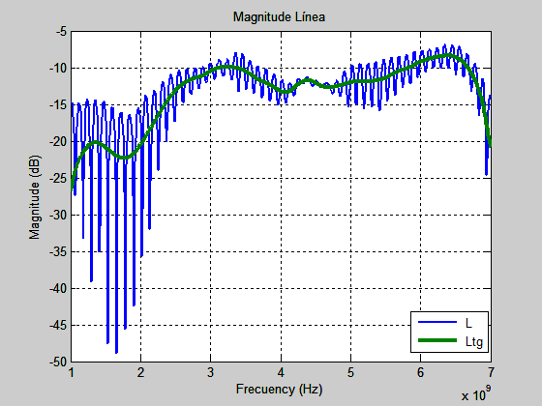
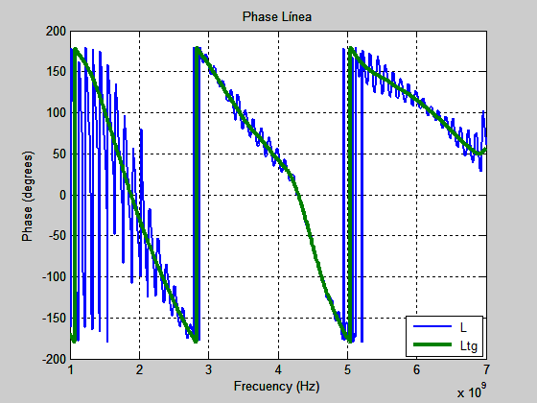

Slide 10
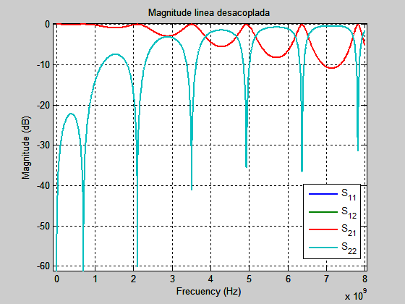
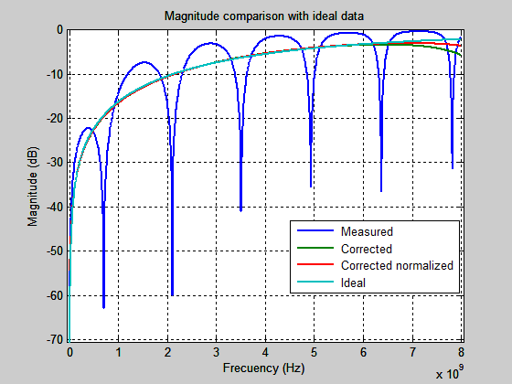
Use examples: circuit with 3 lines and 2 capacitors, Ch4 of Handbook of Microwave Component Measurements (with Advanced VNA Techniques)

Slide 11
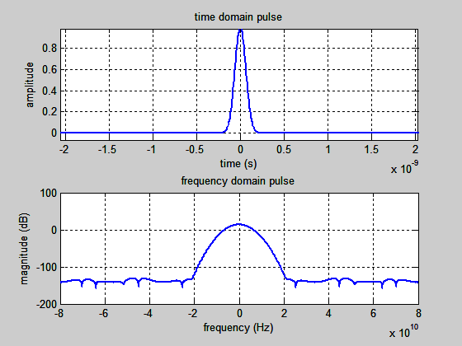
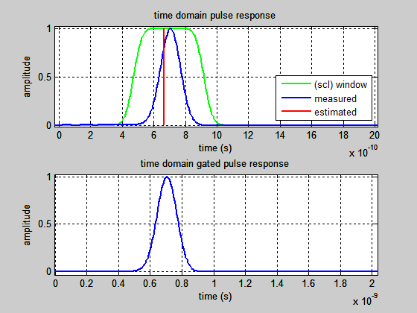

Slide 12
Limitations
In order to use time domain effectively, you must be aware of its limitations and ambiguities.
Measurement range (alias-free).
Resolution (response resolution and range resolution).
Effects of masking when dealing with multiple discontinuities.

Slide 13
Further reading
http://cp.literature.agilent.com/litweb/pdf/5989-5723EN.pdf
“S-parameter Data Correction Using Time Domain Gating for PCB and Cable Applications”.
http://incompliancemag.com/article/s-parameter-data-correction-using-time-domain-gating-for-pcb-and-cable-applications/
Lingyu Deng, Xiaolong Chen, YajunLi, “S-Parameters Extraction of a Desired Network with Time-Domain Gates“.
http://www.jpier.org/PIERL/pierl61/14.16050609.pdf

